Slide 1


TheraTouch: Rehabilitative Therapy Using a
Multi-Touch Device – Part I
Team Speakers: John Farris, Mason McGlothlin, Nipuna Perera, Mandy Seremet
Other Team Members: Scott Boykin, Cristina Cline, Jeff Gettel, Andrew Hughes
Computer Science Department, Texas Christian University

Slide 2
Agenda
Project Overview
Microsoft Surface Overview
Development Environment
System Architecture
Activity Design Process
Database Structure
TheraLink Web Application
Summary
2011-2012 Computer Science Department
Texas Christian University

Slide 3
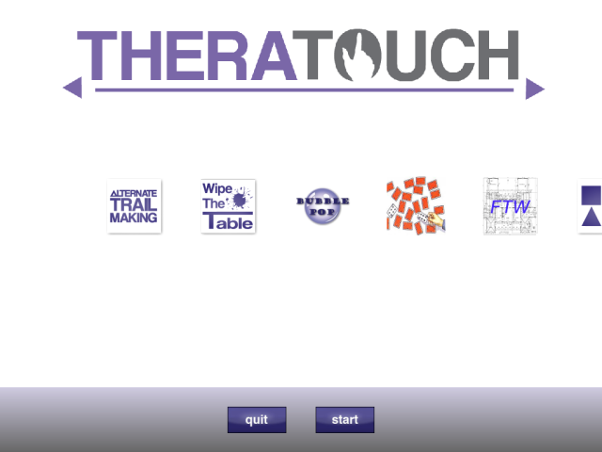
TheraTouch Overview
  Utilize multi-touch technology
  Develop suite of therapeutic activities
  Collect activity results
  Produce reports for
  patient history and
  comparative studies
2011-2012 Computer Science Department
Texas Christian University

Slide 4
System Benefits
  Promotes interaction
    Engaging for user
    Encourages communication with therapist
  Collects and reports metrics
    Reduces use for pen and paper
    Provides visual representation of performance
2011-2012 Computer Science Department
Texas Christian University

Slide 5

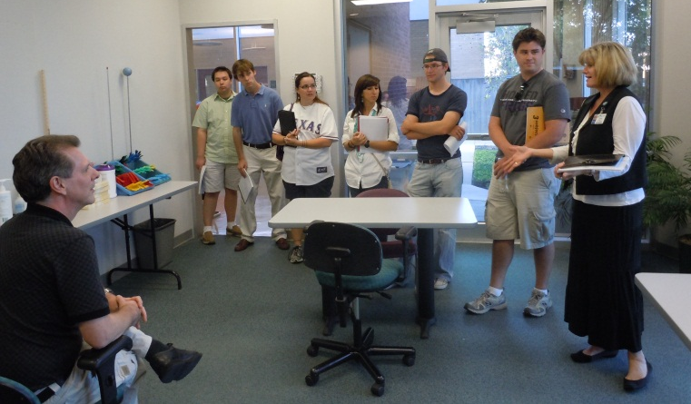
Texas Health Resources
  Physical Medicine & Rehabilitation Department
    Texas Health Harris Methodist (HEB)
  Occupational, Physical, and Speech Therapists
  Neurologist – Human Performance Lab
  Technology Department
2011-2012 Computer Science Department
Texas Christian University

Slide 6
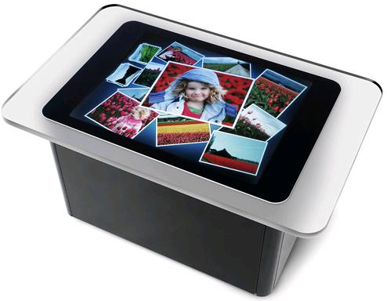
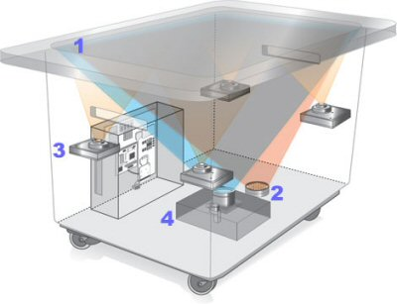
The Microsoft Surface
Multi-touch device
Contains 5 internal cameras
Various input techniques
1024 X 768 display
Captures at ~ 60 times/sec
2011-2012 Computer Science Department
Texas Christian University

Slide 7
Development Environment
Primary Support Environment Operating System Windows 7 – 32-bit File Sharing Subversion Tortoise SVN CoreFTP Lite Server Microsoft SQL Server 2008 R2 SP1 Software Necessary for Project Microsoft Word 2010 Microsoft Excel 2010 Microsoft PowerPoint 2010 Adobe Creative Suite CS4/CS5 Camtasia Studio 7 Microsoft Visio 2010 Microsoft Project 2010 | Microsoft Surface Environment Development of Activities & Framework XNA Game Studio 3.0 Microsoft Surface SDK 1.1 Microsoft Visual Studio 2008 SP1 Microsoft XNA Framework 2.0 Redistributable Microsoft Surface Simulator Web-Application Environment Microsoft Visual Studio 2010 ASP.NET
2011-2012 Computer Science Department
Texas Christian University

Slide 8
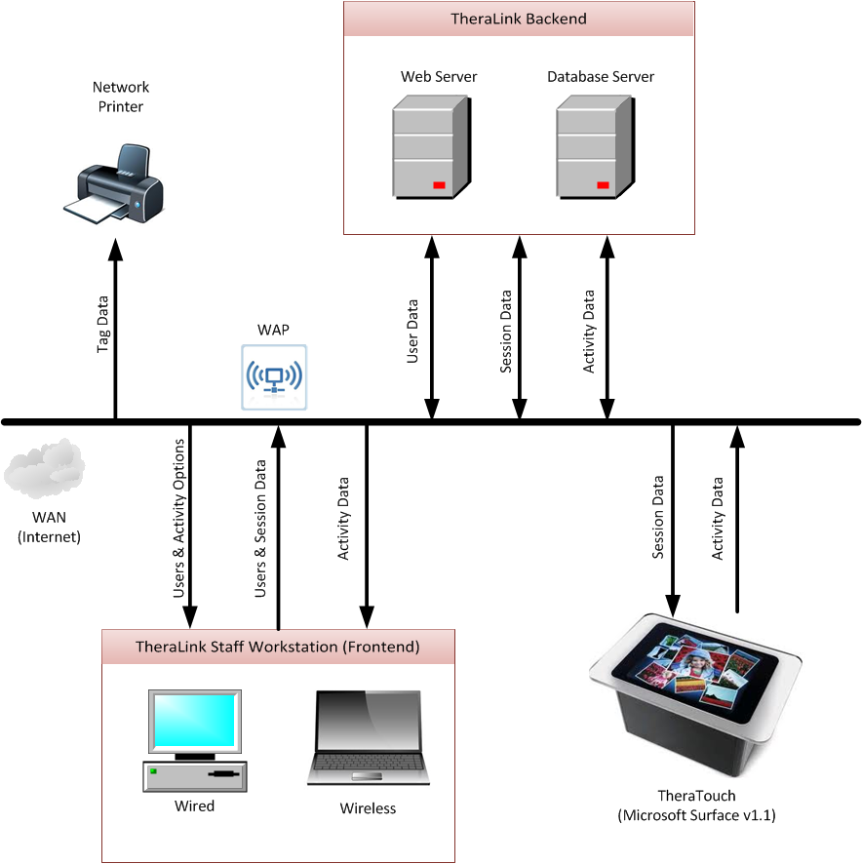
System Architecture
2011-2012 Computer Science Department
Texas Christian University

Slide 9
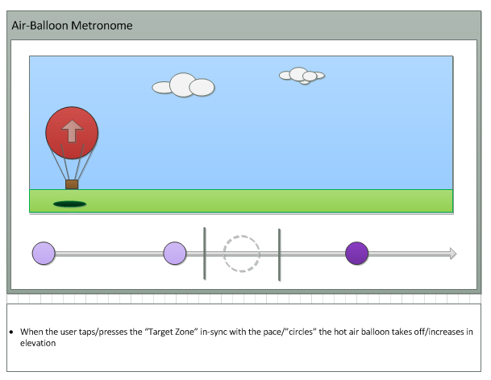
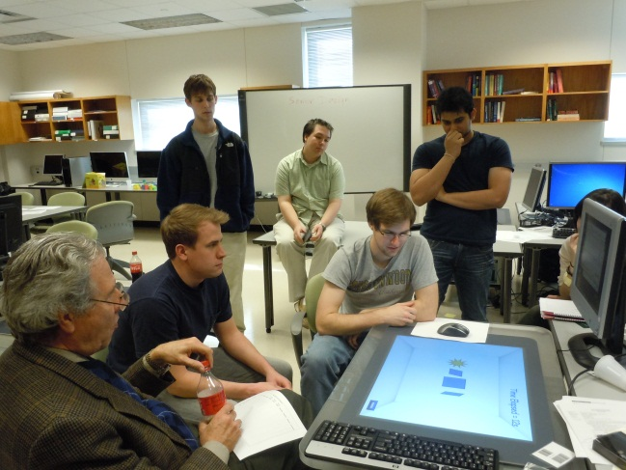
Activity Design Process
  Initial clinic visits
  Research regarding current practice
  Extensive input from occupational, physical, and speech therapists
  Detailed prototyping
2011-2012 Computer Science Department
Texas Christian University

Slide 10
Activity Suite
 | Occupational | Physical | Speech
Air Balloon Metronome
Alternate Trail Making
Bubble Pop
Block Bash
Card Match
Find the Way
Maze
Odd One Out
Path Track
Seek Shape
Sequence
Shape Match
Vending Machine
What Time Is It
Wipe the Table
2011-2012 Computer Science Department
Texas Christian University

Slide 11
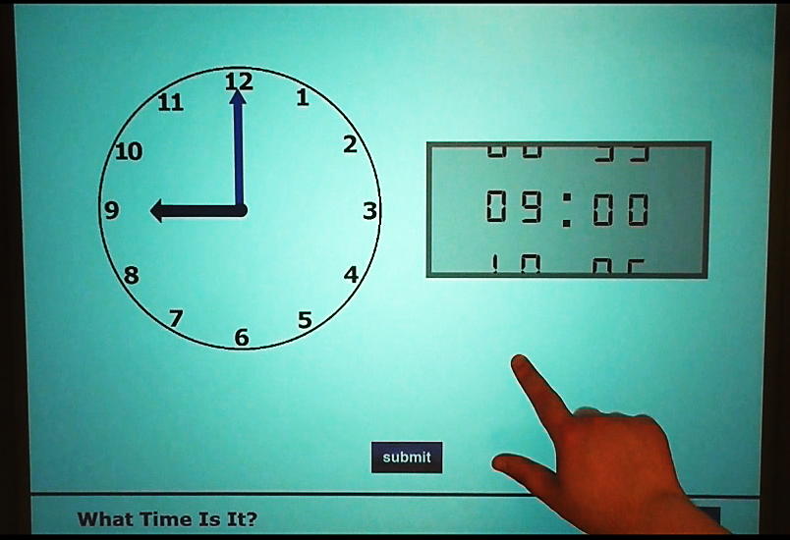
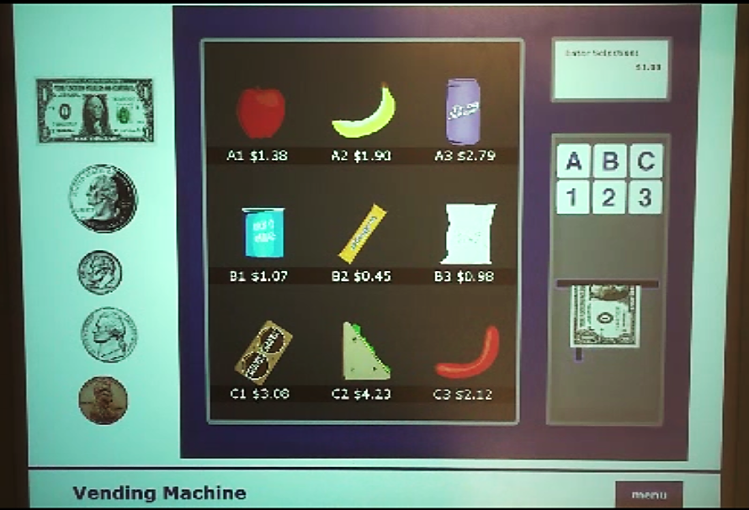
Occupational Therapy
What Time Is It?
Vending Machine
2011-2012 Computer Science Department
Texas Christian University

Slide 12
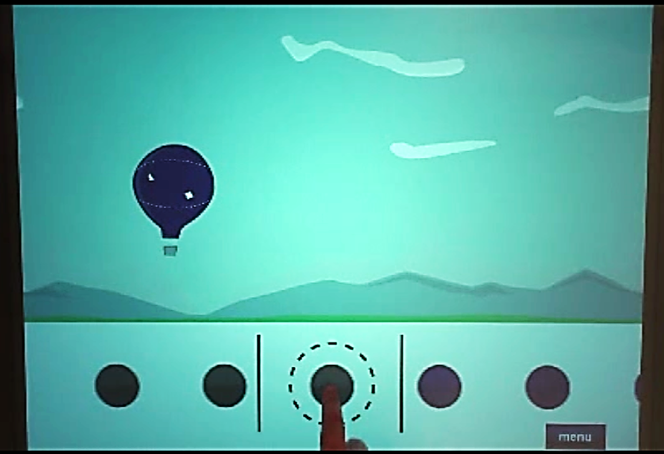
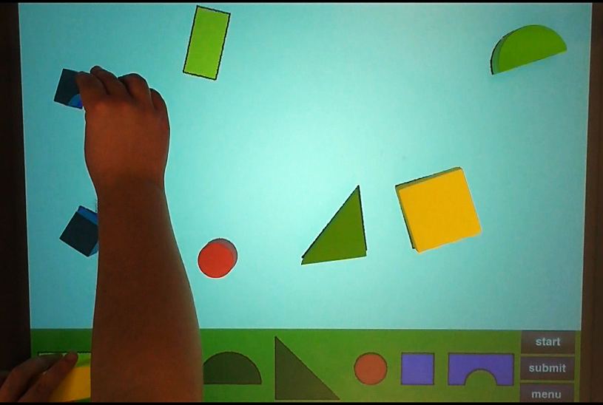
Physical Therapy
Hot Air Balloon Metronome
Block Bash
2011-2012 Computer Science Department
Texas Christian University

Slide 13
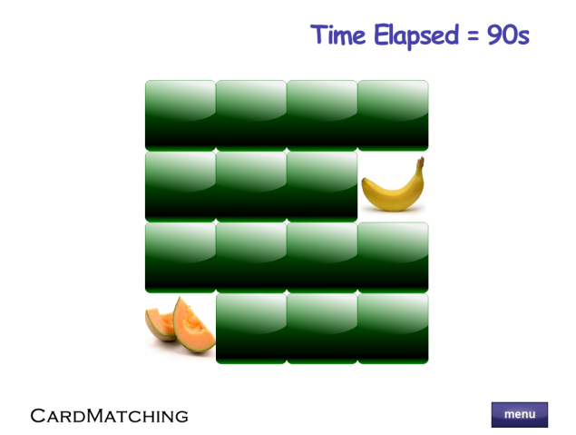
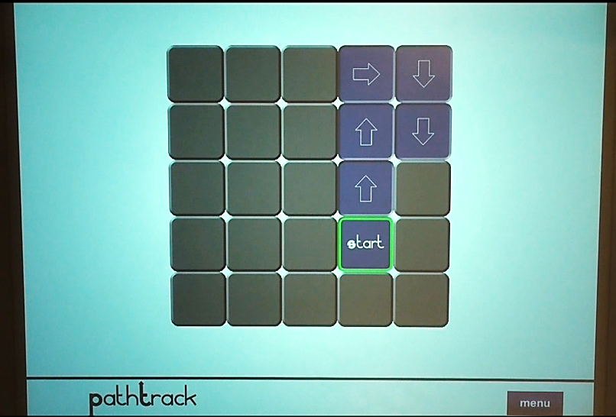
Speech Therapy
Card Match
Path Track
2011-2012 Computer Science Department
Texas Christian University

Slide 14
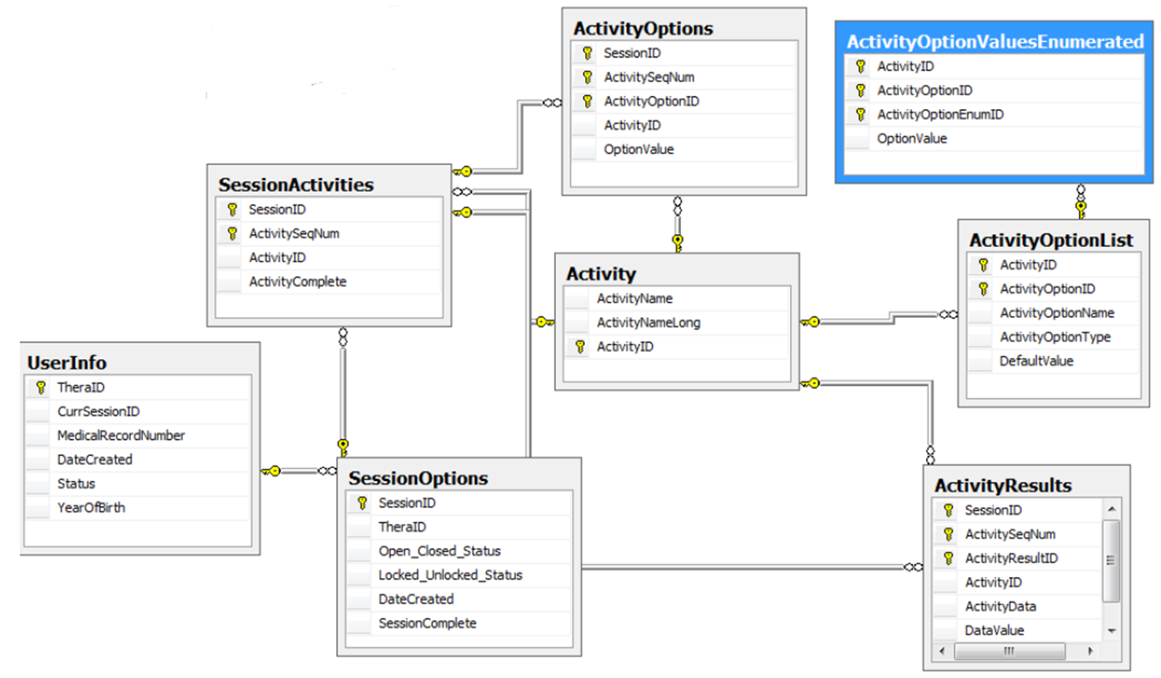
Database Structure
2011-2012 Computer Science Department
Texas Christian University

Slide 15


TheraLink
Create and Manage Users
Create and Manage Sessions for Users
View Results from Sessions
2011-2012 Computer Science Department
Texas Christian University

Slide 16
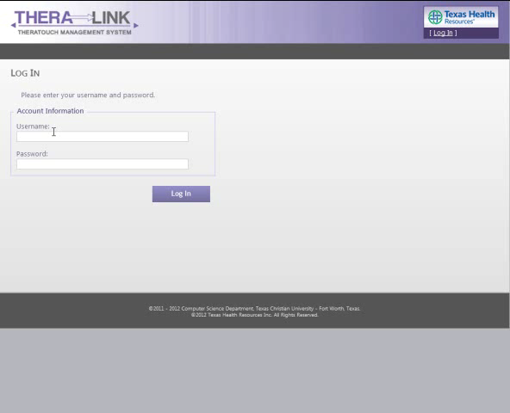
TheraLink – Demonstration
2011-2012 Computer Science Department
Texas Christian University

Slide 17
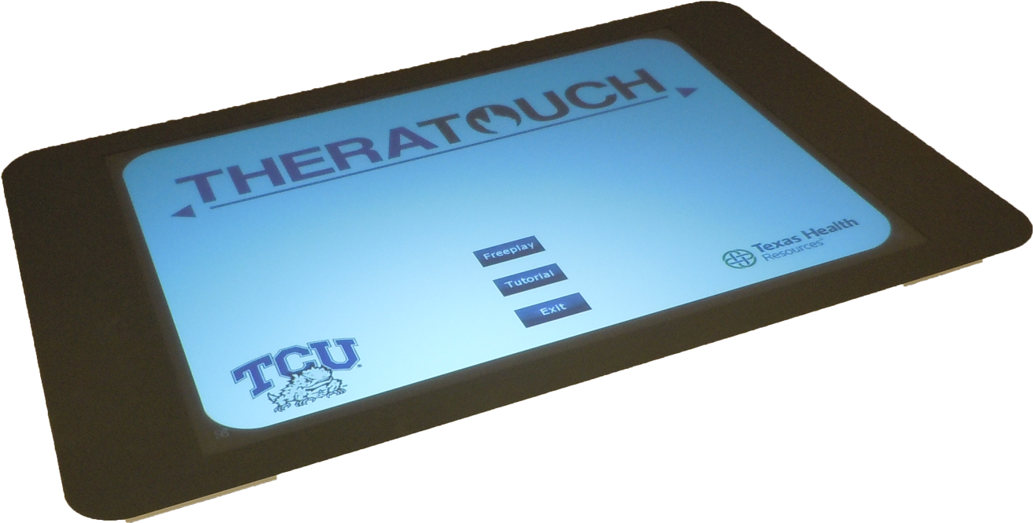
Summary
TheraTouch Overview
Hardware & Software Utilized
Activity Design
TheraLink – Web Application
2011-2012 Computer Science Department
Texas Christian University

Slide 18
TheraTouch: Rehabilitative Therapy Using a
Multi-Touch Device - Part II
Team Speakers: Scott Boykin, Cristina Cline, Jeff Gettel, Andrew Hughes
Other Team Members: John Farris, Mason McGlothlin, Nipuna Perera, Mandy Seremet
Computer Science Department, Texas Christian University

Slide 19
Agenda
Project Overview
Hardware Components
System Architecture
TheraTouch Framework
Activity Development
Activity Demos
TheraLink Reporting
Challenges
Summary
2011-2012 Computer Science Department
Texas Christian University
Notes:
Brief explanation of what each topic will cover

Slide 20
Project Overview
What is the TheraTouch System?
TheraTouch
  Functional and fun
  Custom framework
  Individually packaged activities
TheraLink
  TheraTouch management system
  Data reporting
2011-2012 Computer Science Department
Texas Christian University
Notes:
Overview of system as a whole, overview of TheraTouch and TheraLink(Overview of TT management plus discussion of reporting capabilities)

Slide 21
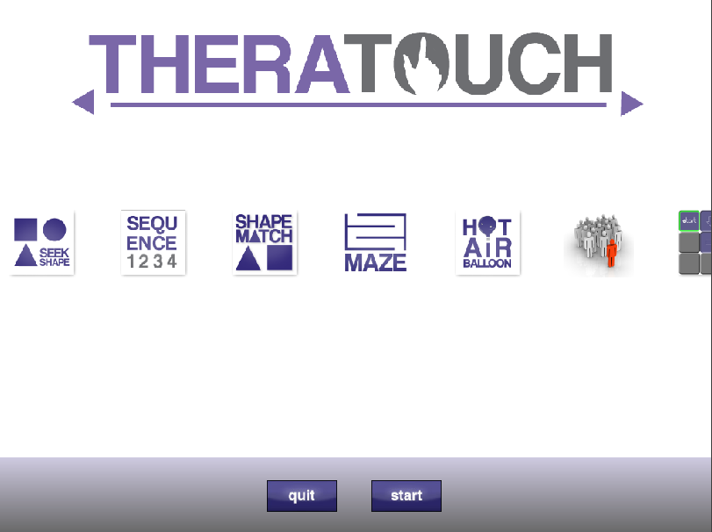
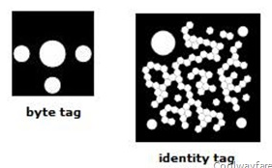
Hardware - Interaction
Multi-touch, multi-user device
5 infrared cameras
2011-2012 Computer Science Department
Texas Christian University

Slide 22
System Architecture
2011-2012 Computer Science Department
Texas Christian University

Slide 23
TheraTouch Framework
Easy Activity Addition
Freeplay and Session Modes
Locked or Unlocked Sessions
Records Data from Activities to Database
Keeps Track of Complete Sessions
2011-2012 Computer Science Department
Texas Christian University

Slide 24
Activity Development
Prototyping
Common Utilities
Common Graphics
Comprehensive collection of activities
  Cover a variety of functional areas
2011-2012 Computer Science Department
Texas Christian University

Slide 25

Functional Evaluation Matrix
Activity | Attention | Categorization | Language | Immediate Memory | Working Memory | Location Memory | Motor Skills | Recognition | Sequencing
Alt. Trial Making
Block Bash
Bubble Pop
Card Match
Find the Way
Maze
Metronome
Odd One Out
Path Track
Sequence
Seek Shape
Shape Match
What Time Is It
Vending Machine
Wipe the Table
2011-2012 Computer Science Department
Texas Christian University

Slide 26
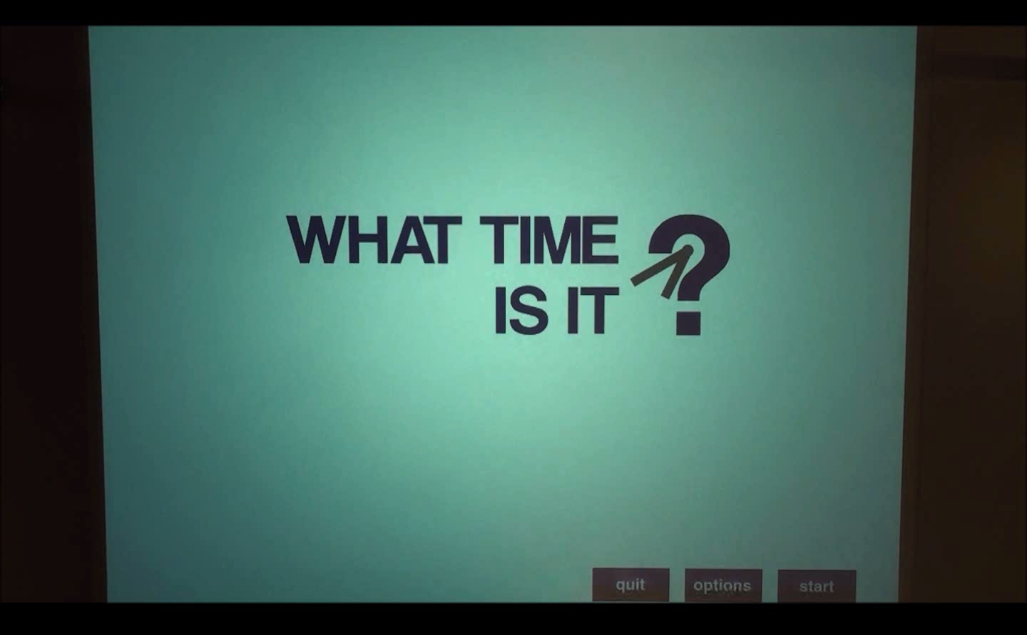
Occupational Therapy – Time
2011-2012 Computer Science Department
Texas Christian University

Slide 27
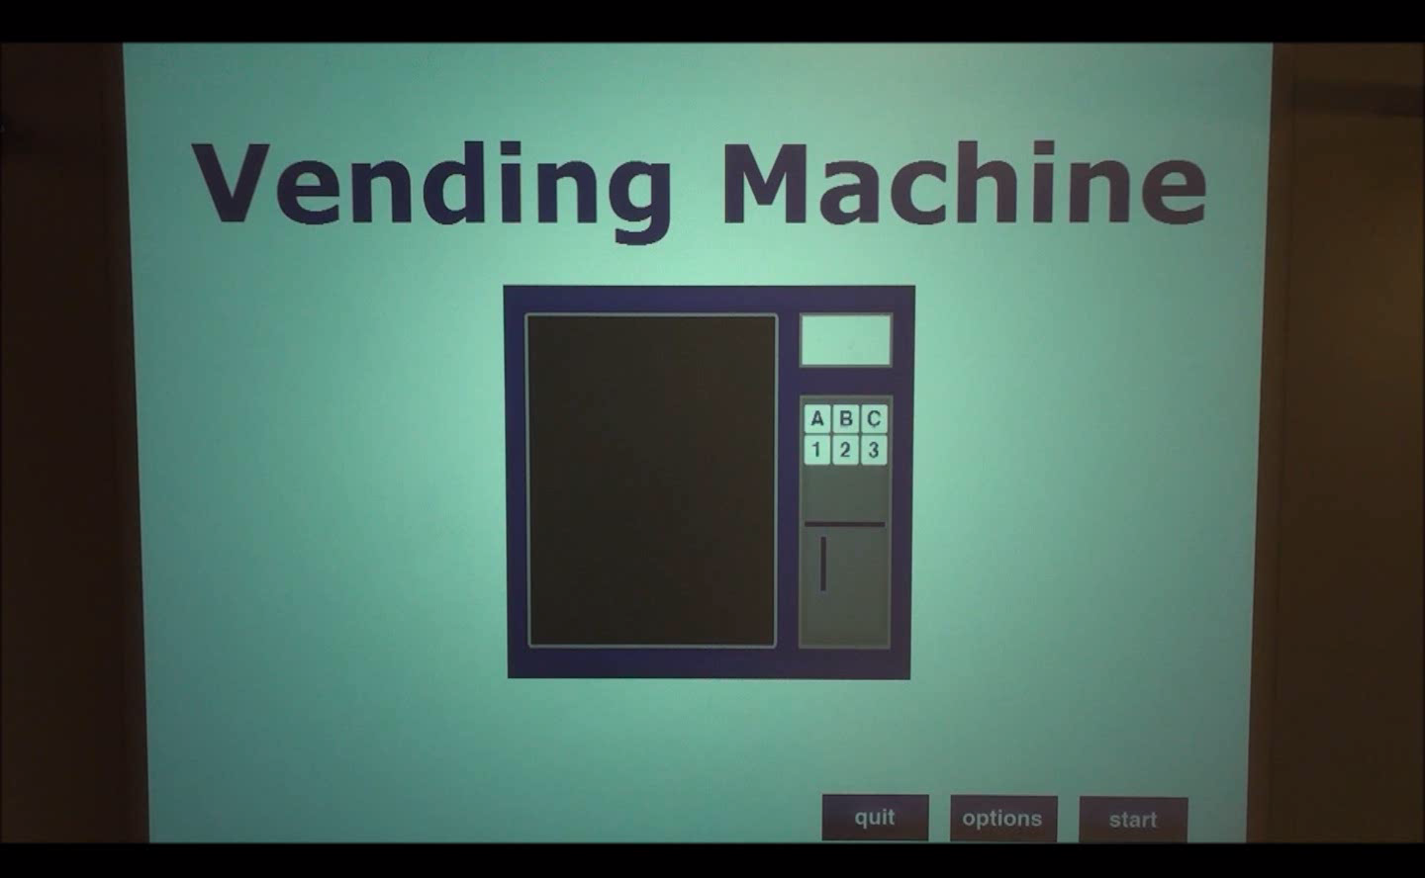
Occupational Therapy – Vending
2011-2012 Computer Science Department
Texas Christian University

Slide 28
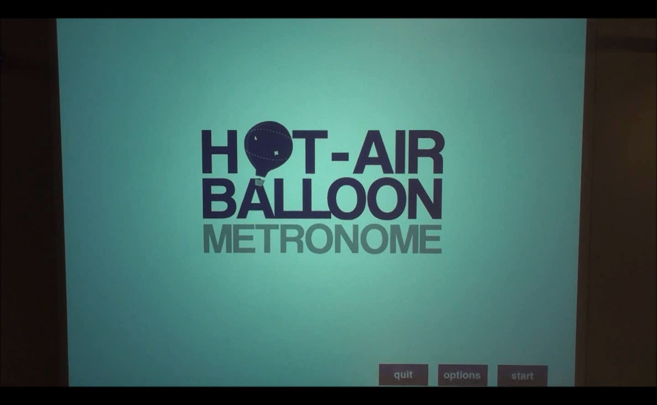
Physical Therapy – Metronome
2011-2012 Computer Science Department
Texas Christian University

Slide 29
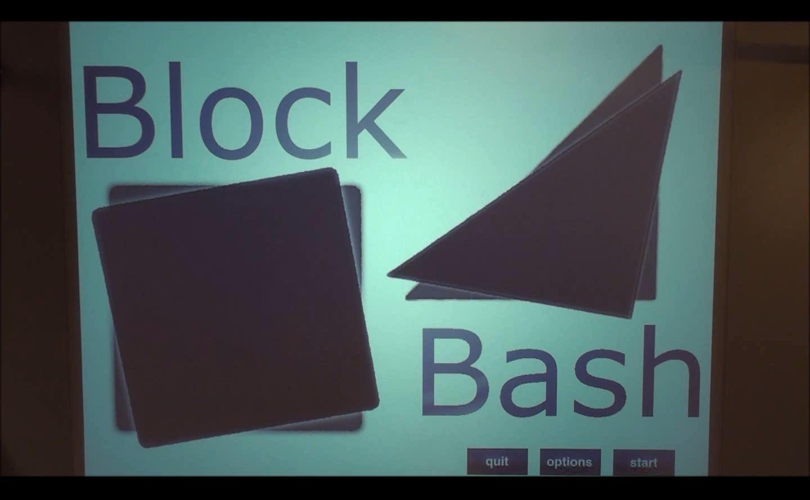
Physical Therapy – Block Bash
2011-2012 Computer Science Department
Texas Christian University

Slide 30
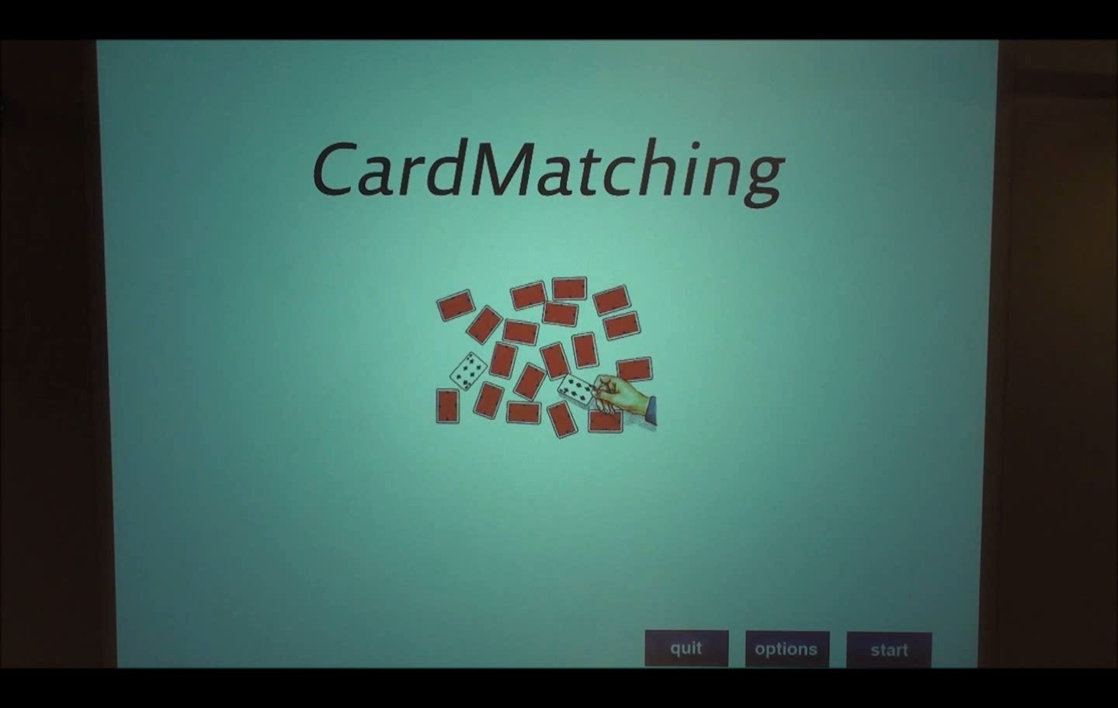
Speech Therapy – Card Match
2011-2012 Computer Science Department
Texas Christian University

Slide 31
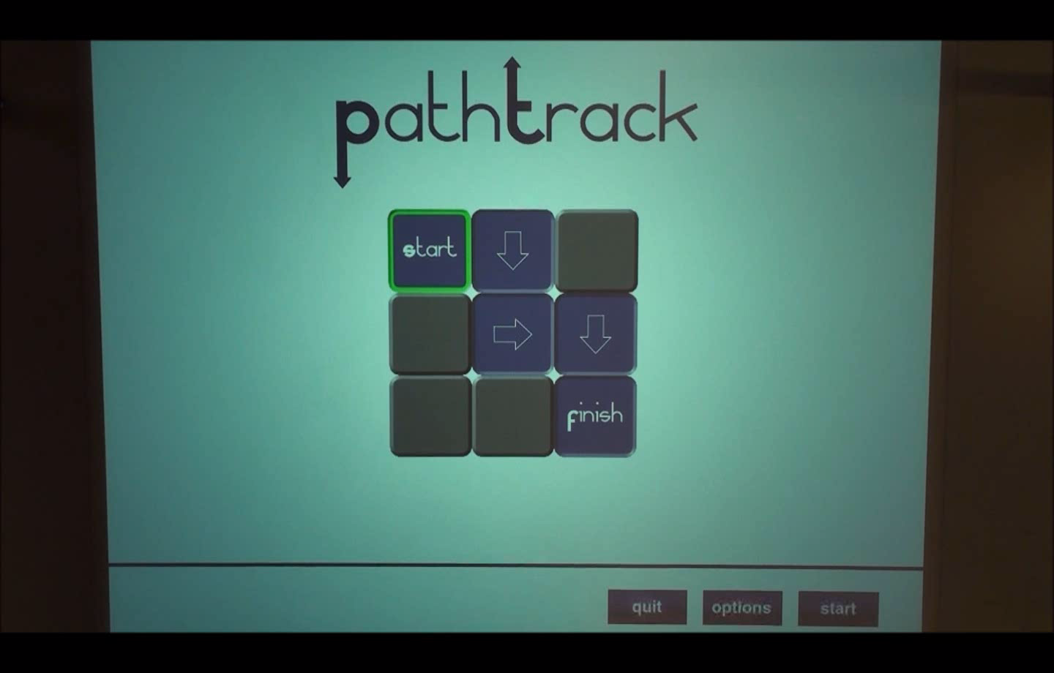
Speech Therapy – Path Track
2011-2012 Computer Science Department
Texas Christian University

Slide 32
TheraLink Reporting
Functionality within TheraLink
Created utilizing SQL Server Reporting Services (SSRS)
Currently plotting Accuracy vs. Time Elapsed
Report user’s progress in therapy
View trends for diagnosis
2011-2012 Computer Science Department
Texas Christian University

Slide 33
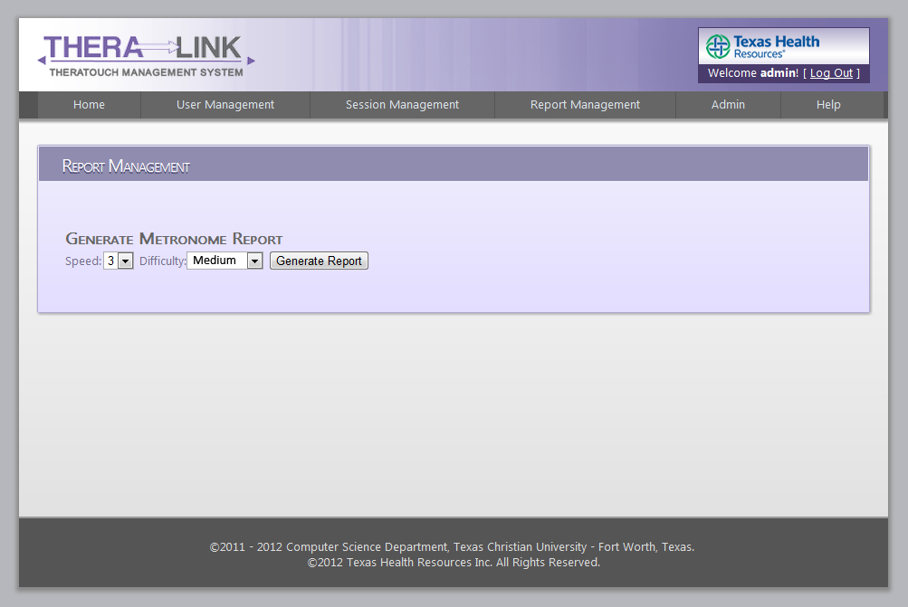
TheraLink Report Management
2011-2012 Computer Science Department
Texas Christian University

Slide 34
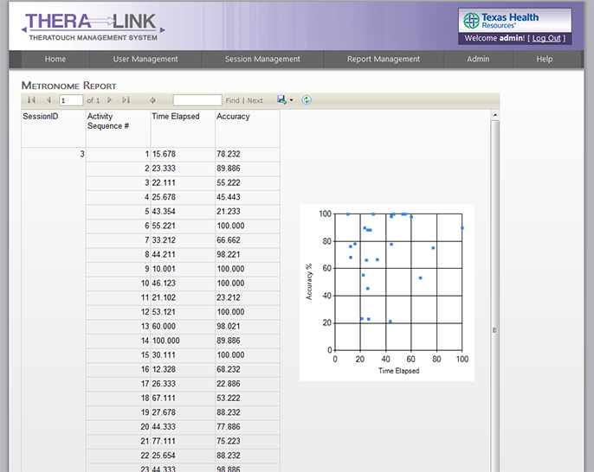
TheraLink Sample Report
2011-2012 Computer Science Department
Texas Christian University

Slide 35
Status of TheraTouch
12 of 15 activities in final system testing
TheraLink
  All but Reporting and Help in final system testing
  Reporting
    Some initial reporting done
    Still meeting with client to better define reports required
Initial System Roll-Out to THR in next 10 days
  User acceptance testing in FreePlay mode
  Setup scripts given to THR (DB and web application)
Final System Roll-Out to THR in mid-April
2011-2012 Computer Science Department
Texas Christian University

Slide 36
Summary
Overview of Project
TheraTouch Framework & Development
Sampling of Activities
TheraLink Reporting
2011-2012 Computer Science Department
Texas Christian University

